Slide 1


Apache openNLP
Herramienta para uso en Procesamiento Inteligente de Texto

Slide 2
How to install
Apache OpenNLP is an open source Java library which is used process Natural Language text. OpenNLP provides services such as tokenization, sentence segmentation, part-of-speech tagging, named entity extraction, chunking, parsing, and co-reference resolution, etc. In this tutorial, we will understand how to use the OpenNLP library to build an efficient text processing service.

Slide 3
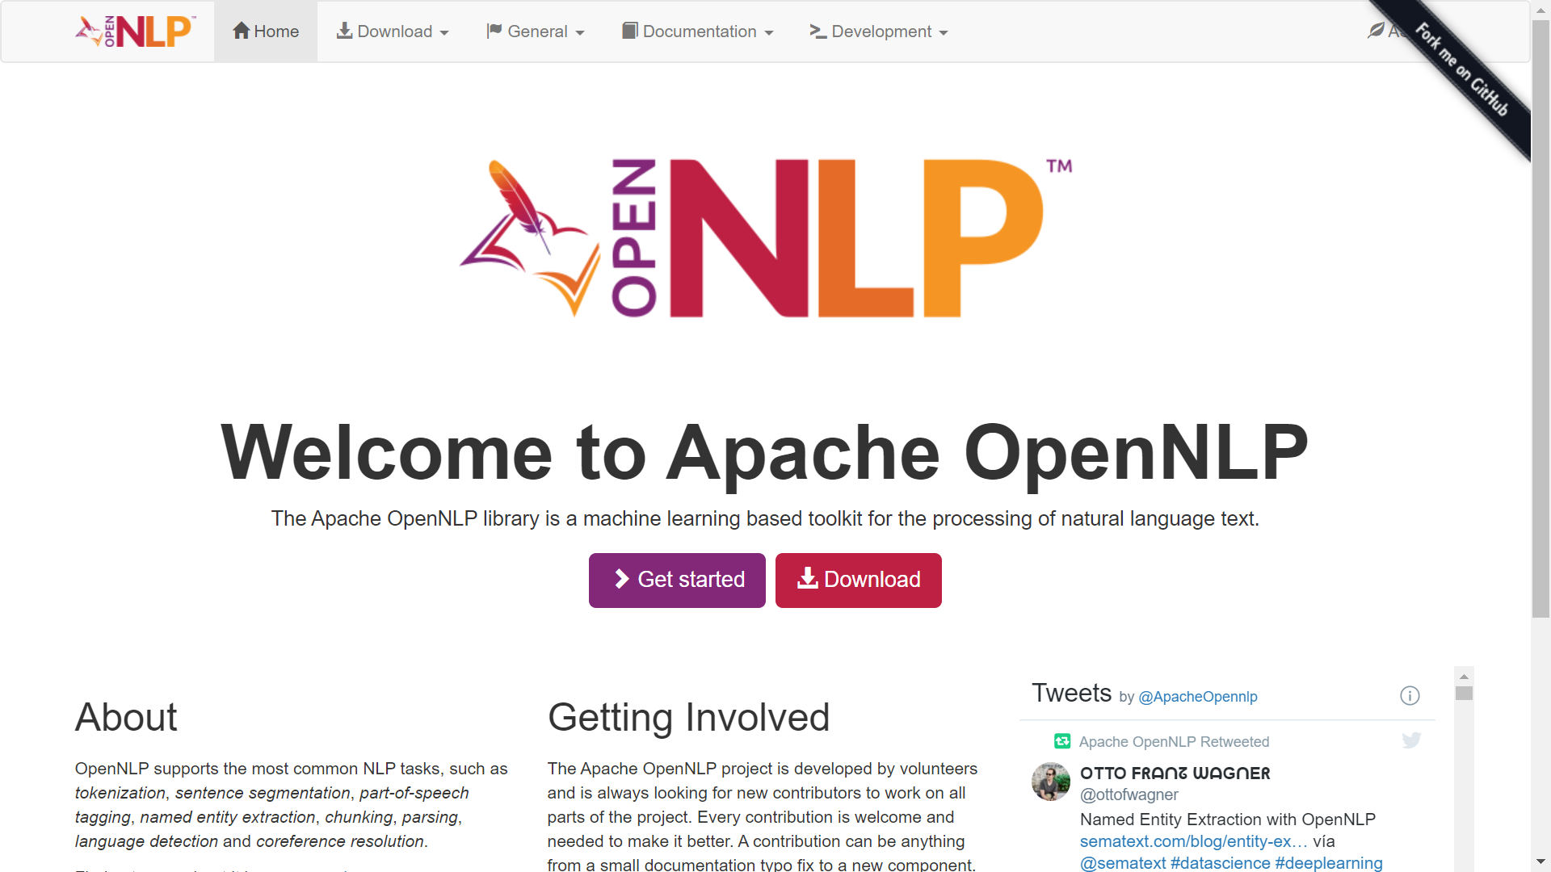

1. Download it from https://opennlp.apache.org/

Slide 4
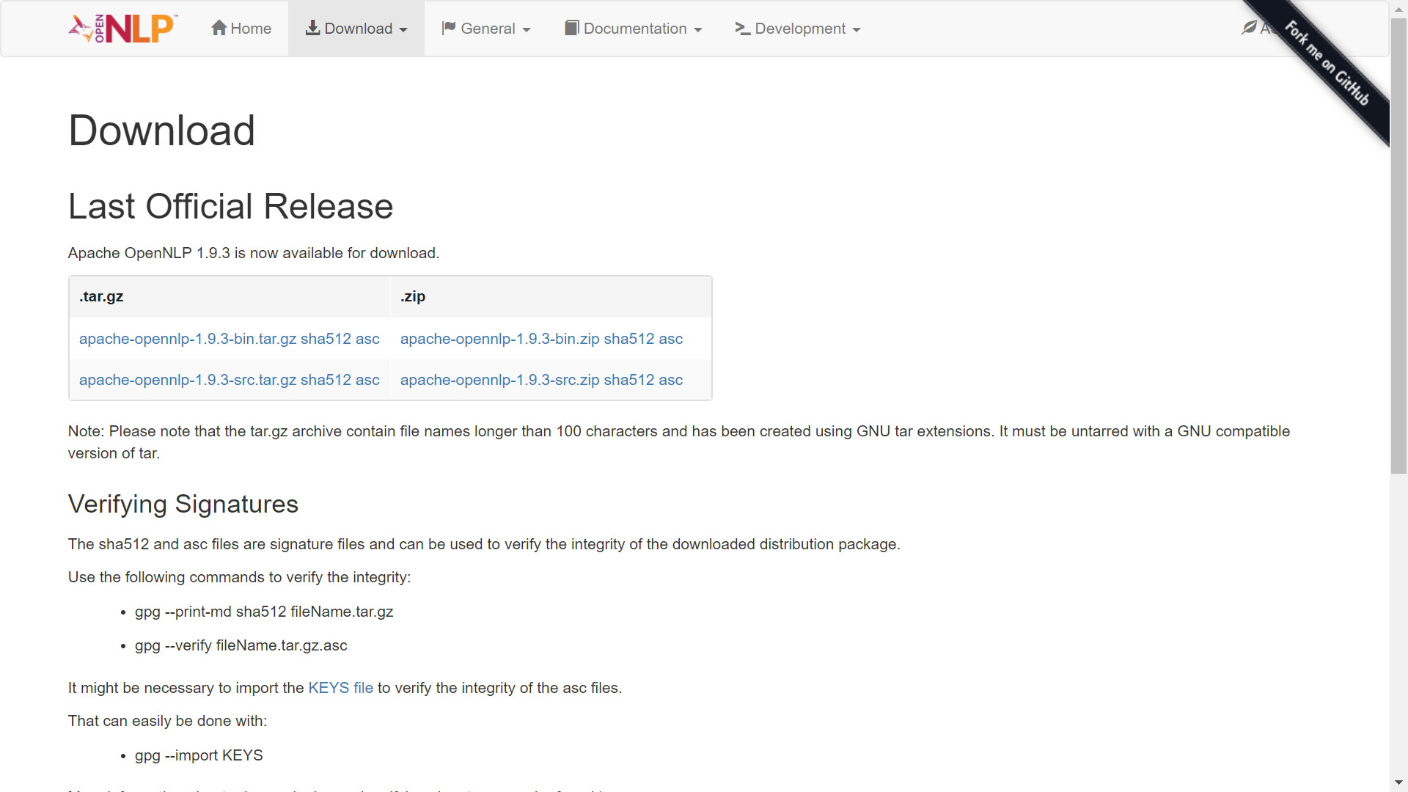
Download the source and binary files, apache-opennlp-1.9.3-bin.zip and apache-opennlp1.9.3-src.zip (for Windows).

Slide 5
Setting the Classpath
After downloading the OpenNLP library, you need to set its path to the bin directory. Assume that you have downloaded the OpenNLP library to the E drive of your system.

Slide 6
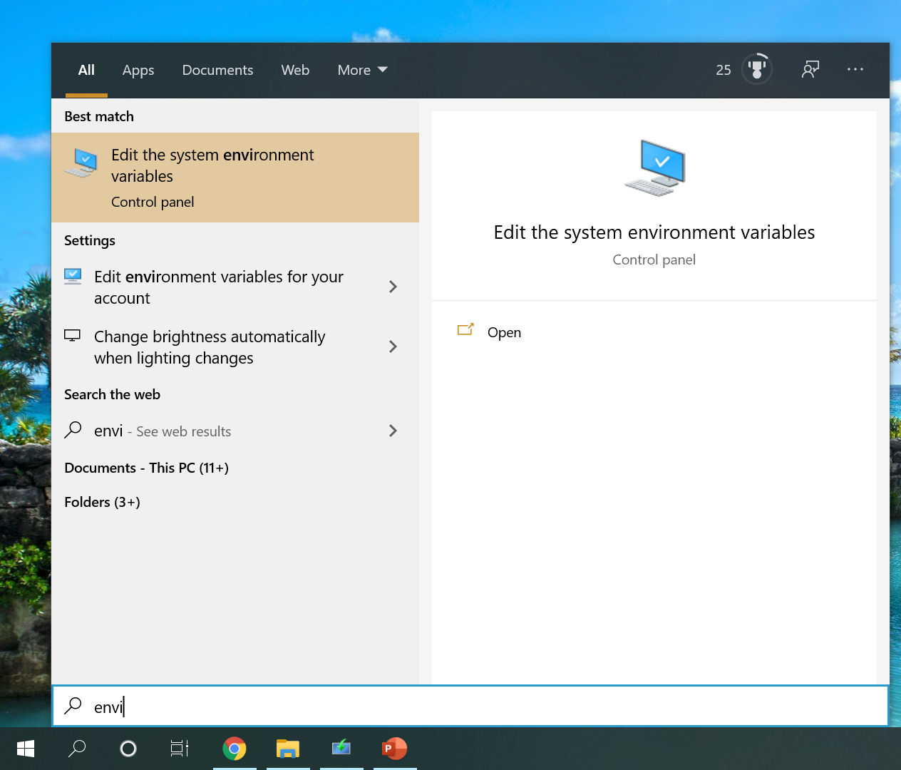
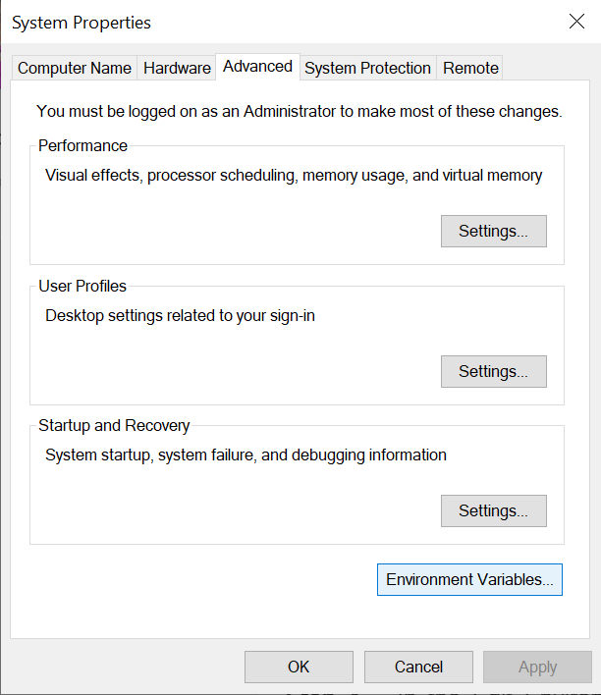




2. Open environment variables settings

Slide 7
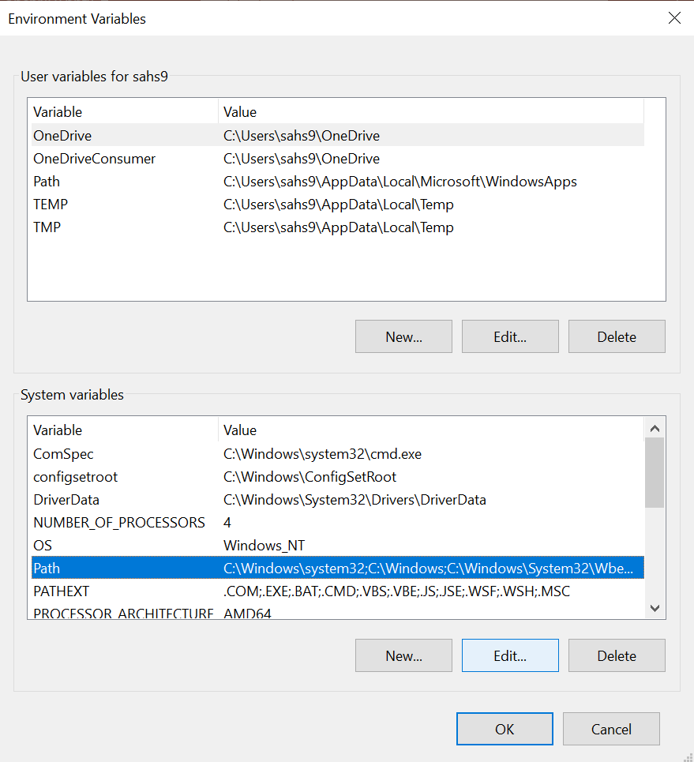

3. Select the path variable and click the Edit button, as shown in the following screenshot.

Slide 8

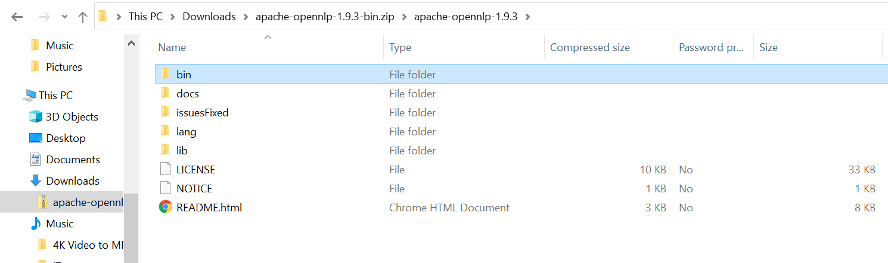
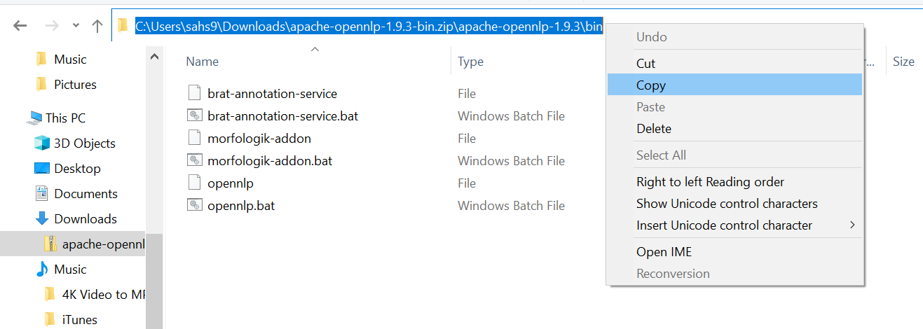
4. Search the path for bin OpenNLP directory.

Slide 9
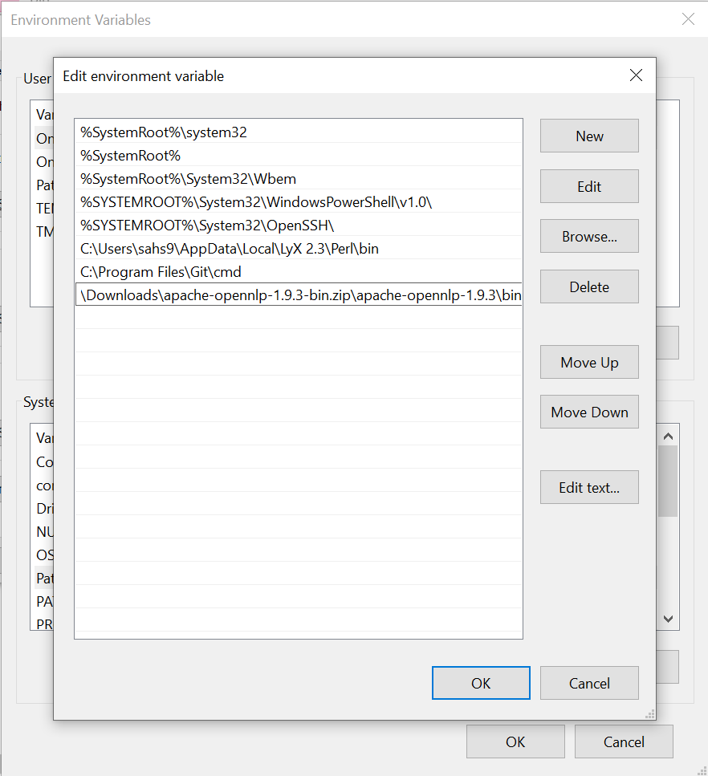

5. In the Edit Environment Variable window, click the New button and add the path for OpenNLP directory and click the OK button.

Slide 10
Setting in your project
You can set the Eclipse environment for OpenNLP library, either by setting the Build path to the JAR files or by using pom.xml.

Slide 11
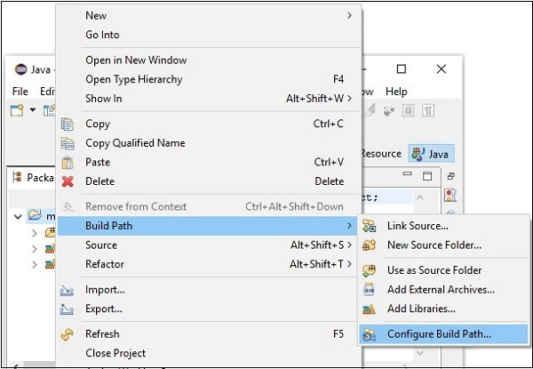

6. After creating a new project, right-click on it, select Build Path and click Configure Build Path.

Slide 12
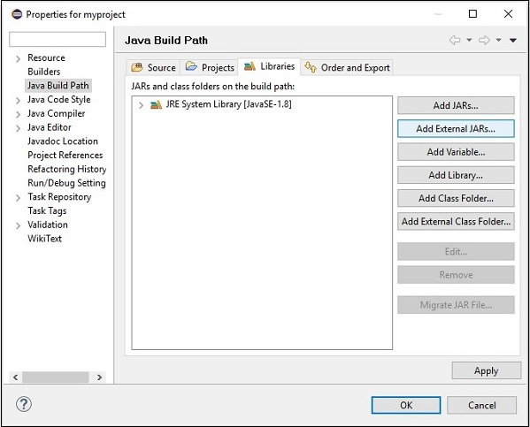

7. Next, you will get the Java Build Path wizard. Here, click the Add External JARs.

Slide 13
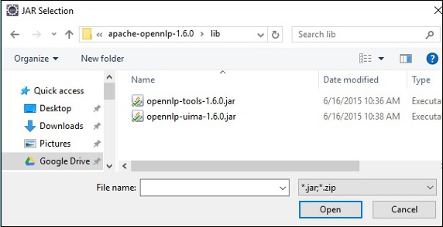
8. Next, you will get the Java Build Path wizard. Here, click the Add External JARs button.
On clicking the Open button in the above screen, the selected files will be added to your library.

Slide 14
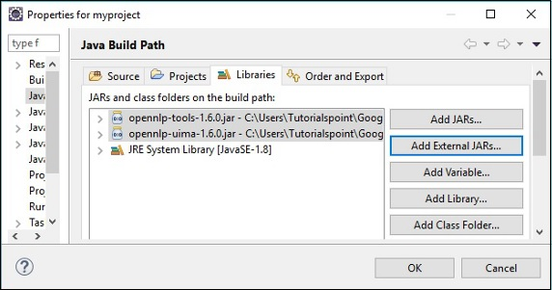
On clicking OK, you will successfully add the required JAR files to the current project

Slide 15
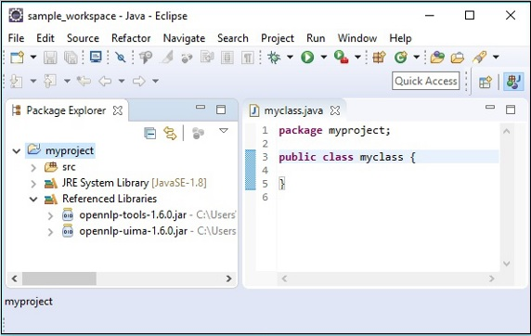
and you can verify these added libraries by expanding the Referenced Libraries, as shown here.

